Slide 1
Java Capability
Threads in java

Slide 2
Agenda
We are learning what is thread
What is multi threading
Lifecycle of thread
Usage of your application owning Thread class
Usage of your application owning Runnable
Synchronization of thread

Slide 3
Prerequisites
Basic programming skill
Understanding of OOPS
Java knowledge mandatory

Slide 4
Threads
Multithreading is a Java feature that allows concurrent execution of two or more parts of a program for maximum utilization of CPU. Each part of such program is called a thread. So, threads are light-weight processes within a process. Threads can be created by using two mechanisms : 1. Extending the Thread class 2. Implementing the Runnable Interface
JVM initiate a thread when your program is called the Main Thread.

Slide 5
Why do we need threads?
To enhance parallel processing
To increase response to the user
To utilize the idle time of the CPU
Prioritize your work depending on priority

Slide 6
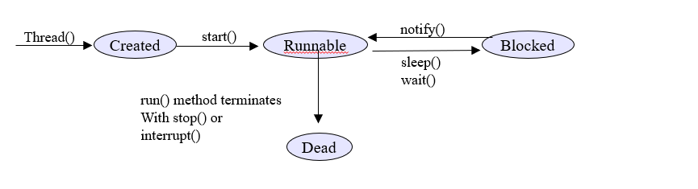
Life Cycle of Thread
Life cycle of thread is classified into four stages
Created or new born stage
Runnable or running stage
Blocked stage
Dead stage
Thread()
start()
notify()
Created
Runnable
Blocked
sleep()
wait()
run() method terminates
With stop() or
interrupt()
Dead

Slide 7
Thread states
New : A thread begins its life cycle in the new state. It remains in this state until the start() method is called on it.
Runnable : After invocation of start() method on new thread, the thread becomes runnable.
Blocked – A thread that is blocked waiting for a monitor lock is in this state
Running : A thread is in running state if the thread scheduler has selected it.
Waiting : A thread is in waiting state if it waits for another thread to perform a task. In this stage the thread is still alive.
Terminated : A thread enter the terminated state when it complete its task

Slide 8
Thread Class vs Runnable Interface
1. If we extend the Thread class, our class cannot extend any other class because Java doesn’t support multiple inheritance. But, if we implement the Runnable interface, our class can still extend other base classes. 2. We can achieve basic functionality of a thread by extending Thread class because it provides some inbuilt methods like yield(), interrupt() etc. that are not available in Runnable interface.

Slide 9
Methods of Thread class.
static Thread | currentThread() Returns a reference to the currently executing thread object.
String | getName() Returns this thread's name.
int | getPriority() Returns this thread's priority.
StackTraceElement[] | getStackTrace() Returns an array of stack trace elements representing the stack dump of this thread.
Thread.State | getState() Returns the state of this thread.
void | interrupt() Interrupts this thread.
boolean | isAlive() Tests if this thread is alive.

Slide 10
Methods of Thread class.
void | run() If this thread was constructed using a separate Runnable run object, then that Runnable object's run method is called; otherwise, this method does nothing and returns.
void | setName(String name) Changes the name of this thread to be equal to the argument name.
void | setPriority(int newPriority) Changes the priority of this thread.
static void | sleep(long millis) Causes the currently executing thread to sleep (temporarily cease execution) for the specified number of milliseconds, subject to the precision and accuracy of system timers and schedulers.
void | start() Causes this thread to begin execution; the Java Virtual Machine calls the run method of this thread.

Slide 11
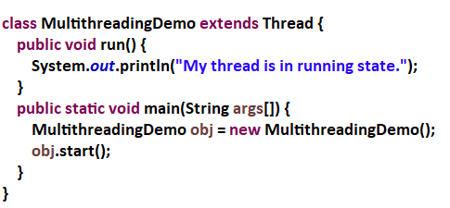
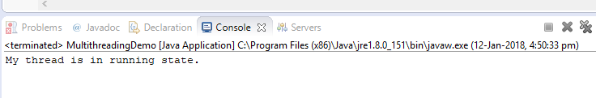
Thread creation by extending Thread class
Output:

Slide 12
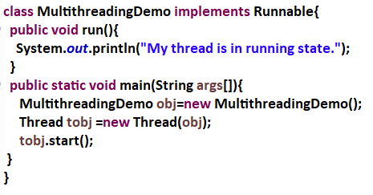
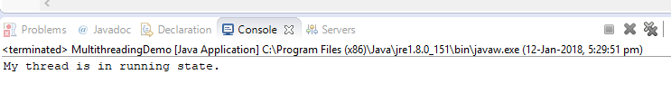
Thread creation by implementing Runnable Interface
Output:

Slide 13
Difference between start() & run()
The method start() will activate the state of the thread, this is once in it’s life time.
The method run() makes the thread in execution mode until it’s required plan is in progress.
The method start() calls run() method implicitly.
Hence, run method need not required to be called separately.

Slide 14
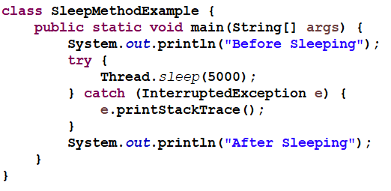
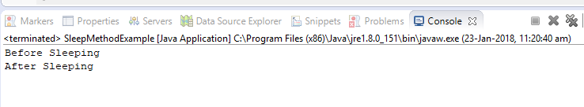
Sleep() method
Thread.sleep() method makes the currently executing thread to pause it’s execution for a specified period of time.
Output:

Slide 15
Name a Thread
You can give a name to a thread by using setName() method of Thread class. You can also retrieve the name of a thread using getName() method of a Thread class. These two methods are public and final. Below is the method signatures of these methods.
1) public final void setName(String name) —-> It changes the name of the thread to “name”.
2) public final String getName() —-> Returns the name of the thread

Slide 16
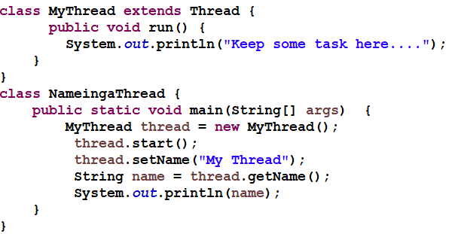

Name a Thread
Output:

Slide 17
Thread priorities
Thread priorities are the integers which decide how one thread should be treated with respect to the others.
Thread priority decides when to switch from one running thread to another, process is called context switching
A thread can voluntarily release control and the highest priority thread that is ready to run is given the CPU.
To set the priority of the thread setPriority() method is used which is a method of the class Thread Class.
In place of defining the priority in integers, we can use MIN_PRIORITY, NORM_PRIORITY or MAX_PRIORITY.
Default priority of a thread is 5 (NORM_PRIORITY). The value of MIN_PRIORITY is 1 and the value of MAX_PRIORITY is 10.

Slide 18
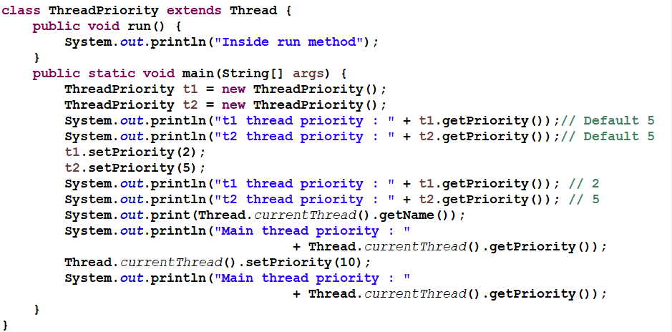
Thread priorities Example Contd..

Slide 19
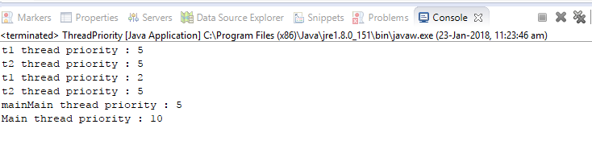
Thread priorities Output

Slide 20
isAlive() and join()
In all the practical situations main thread should finish last else other threads which have spawned from the main thread will also finish.
To know whether the thread has finished we can call isAlive() on the thread which returns true if the thread is not finished.
Another way to achieve this by using join() method, this method when called from the parent thread makes parent thread wait till child thread terminates.
These methods are defined in the Thread class.

Slide 21
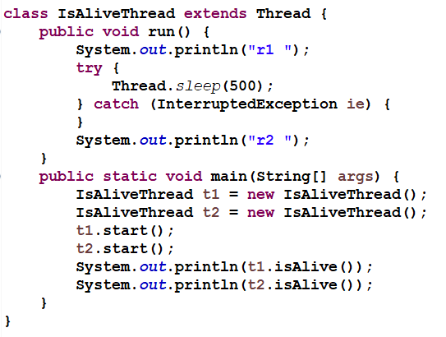
IsAlive() Example

Slide 22
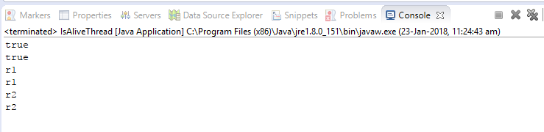
Output

Slide 23
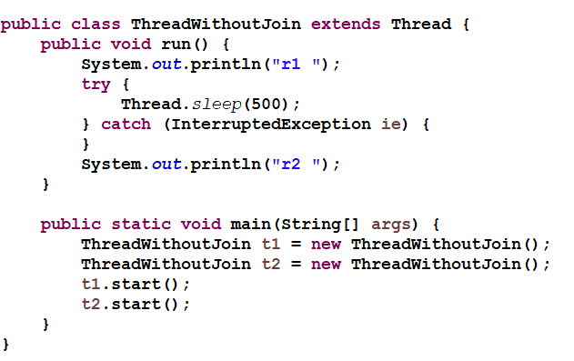
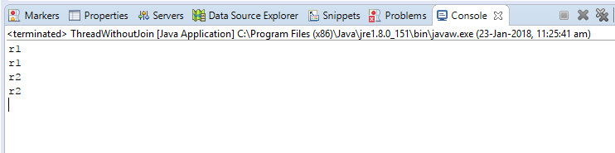
Example of thread without join() method
Output:

Slide 24
Example of thread without join() method
In this above program two thread t1 and t2 are created. t1 starts first and after printing "r1" on console thread t1 goes to sleep for 500 ms. At the same time Thread t2 will start its process and print "r1" on console and then go into sleep for 500 ms. Thread t1 will wake up from sleep and print "r2" on console similarly thread t2 will wake up from sleep and print "r2" on console. So you will get output like r1 r1 r2 r2

Slide 25
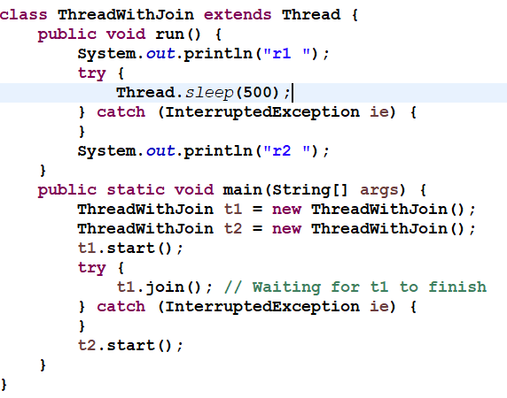
Example of thread with join() method
Output:

Slide 26
Synchronization
Multithreading introduces asynchronous behavior to the programs. If a thread is writing some data another thread may be reading the same data at that time. This may bring inconsistency.
When two or more threads need access to a shared resource there should be some way that the resource will be used only by one resource at a time. The process to achieve this is called synchronization.
To implement the synchronous behavior java has synchronous method. Once a thread is inside a synchronized method, no other thread can call any other synchronized method on the same object. All the other threads then wait until the first thread come out of the synchronized block.

Slide 27
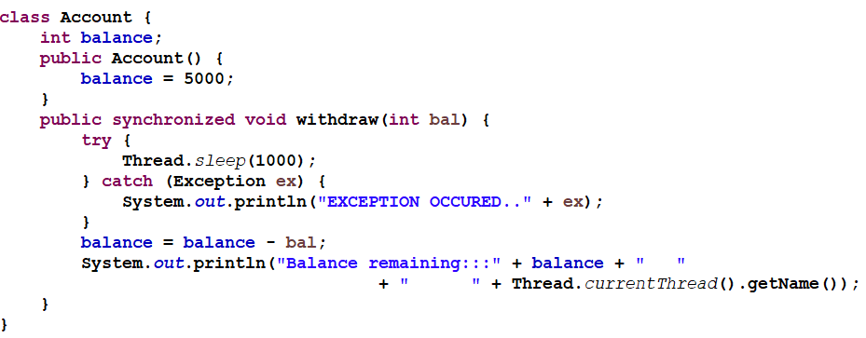
Synchronization EXAMPLE

Slide 28
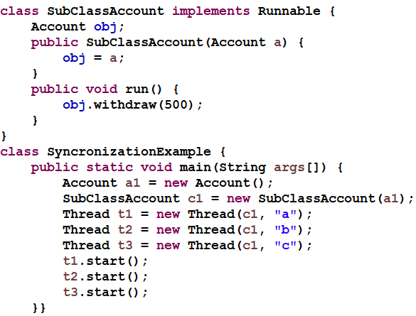
Example

Slide 29
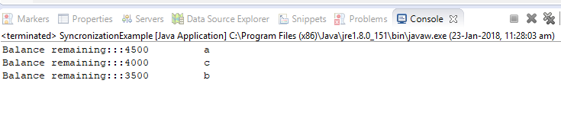
Output

Slide 30
Inter-thread Communication
We have few methods through which java threads can communicate with each other. These methods are wait(), notify(), notifyAll(). All these methods can only be called from within a synchronized method.
1) To understand synchronization java has a concept of monitor. Monitor can be thought of as a box which can hold only one thread. Once a thread enters the monitor all the other threads have to wait until that thread exits the monitor.
2) wait() tells the calling thread to give up the monitor and go to sleep until some other thread enters the same monitor and calls notify().
3) notify() wakes up the first thread that called wait() on the same object.notifyAll() wakes up all the threads that called wait() on the same object. The highest priority thread will run first.

Slide 31
Difference between sleep and wait
wait() | sleep()
called from synchronised block | no such requirement
monitor is released | monitor is not released
gets awake when notify() or notifyAll() method is called. | does not get awake when notify() or notifyAll() method is called
not a static method | static method
wait() is generaly used on condition | sleep() method is simply used to put your thread on sleep.

Slide 32
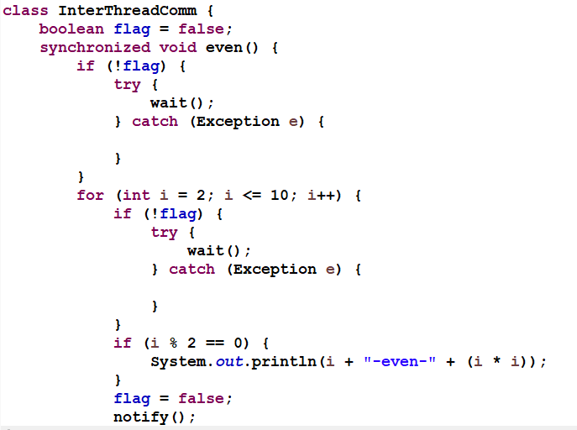
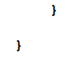
Example

Slide 33
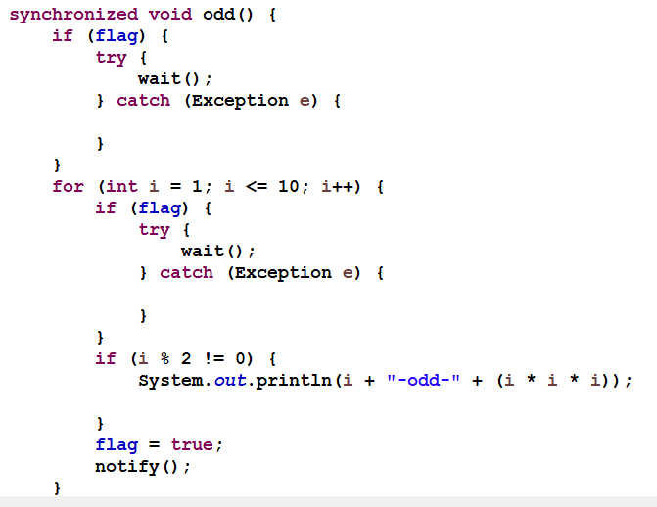
EXAMPLE

Slide 34
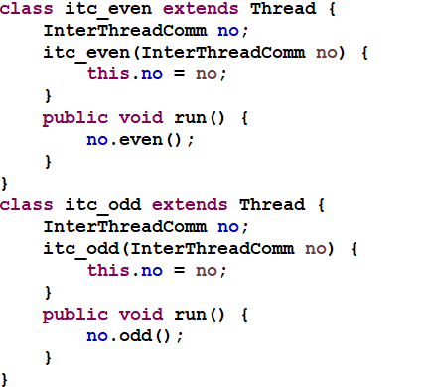
EXAMPLE

Slide 35
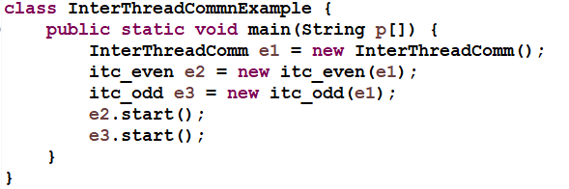
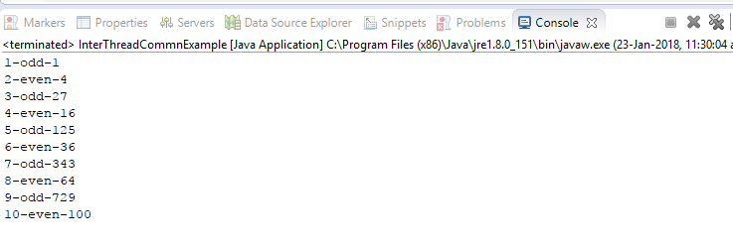
EXAMPLE
Output:

Slide 36
Which can be synchronized
Methods
Blocks
Ex:
Synchronizing method:
public synchronized void hello(){
// some body
}
In this case the object to be synchronized will be passed
as a parameter to synchronized block.
synchronized(object){
// your code here;
}

Slide 37
What is Wrapper class
Wrapper classes are used to convert any data type into an object.
The class that converts data of primitive type to Object type.
Wrapper class will also support for the concept of auto-boxing and auto-un-boxing.

Slide 38
List of wrapper classes
LIST OF WRAPPER CLASSES
IN THE ABOVE CODE, INTEGER CLASS IS KNOWN AS A WRAPPER CLASS (BECAUSE IT WRAPS AROUND INT DATA TYPE TO GIVE IT AN IMPRESSION OF OBJECT). TO WRAP (OR TO CONVERT) EACH PRIMITIVE DATA TYPE, THERE COMES A WRAPPER CLASS. EIGHT WRAPPER CLASSES EXIST IN JAVA.LANG PACKAGE THAT REPRESENT 8 DATA TYPES. FOLLOWING LIST GIVES.
Primitive data type | Wrapper class
byte | Byte
short | Short
int | Integer
long | Long
float | Float
double | Double
char | Character
boolean | Boolean

Slide 39
Importance of Wrapper classes
There are mainly two uses with wrapper classes.
To convert simple data types into objects, that is, to give object form to a data type; here constructors are used.
To convert strings into data types (known as parsing operations), here methods of type parseXXX() are used.

Slide 40
Boxing and Autoboxing
Before JDK1.5 version
int num=14; // primitive value
Integer intObj= new Integer(num); //boxed to Integer object type. Is called boxing
From jdk1.5 version
int num=14; //primitive value
Integer intObj = num; // automatically boxed to object of Integer type is called autoboxing

Slide 41
Un-boxing &Auto-un-boxing
Before JDK1.5 version
int num=14; // primitive value
Integer intObj= new Integer(num); //boxed to Integer object type. Is called boxing
Int num1=intObj.intValue(); // called Un boxing
From jdk1.5 version
int num=14; //primitive value
Integer intObj = num; // automatically boxed to object of Integer type is called autoboxing
int num1=intObj; // is called auto unboxing

Slide 42
Quiz
Which of these is not a Thread state?
a.New b.Runnable c.sleep d.terminated
What state does Thread enter in when it has been created and started?
a.New b.Runnable c.Running d.Waiting

Slide 43
Quiz
How can you ensure all threads that started from main must end in order in which they started and also main should end in last
a.join() method b.sleep() method c.wait() method d.run() method
What is difference between starting thread with run() and start() method?
a.There is no difference b.When you call start() method, main thread internally calls run() method to start newly created Thread c.run() calls start() method internally d.None

Slide 44
Summary
We understood what is thread and multi threading.
Lifecycle of thread follows four stages to controll accessing of thread
We can code application owning Thread class.
We can code with the Usage Runnable.
Synchronization of thread makes our application with the prioritized execution.

Slide 45
References & Further Studies
https://www.tutorialspoint.com/java/java_multithreading.htm
http://www.java2novice.com/java_thread_examples/
https://docs.oracle.com/javase/tutorial/essential/concurrency/simple.html
https://beginnersbook.com/2013/03/multithreading-in-java/

